Slide 1



Predictive analysis: A series of model building exercises
Build and Evaluate Time-Series, Regression and Classification Models
Will Hinton
College of Business, Engineering, and Technology (COBET)
National University
DDS-8555 v5: Statistical Modeling
Professor Mohamed Nabeel
May 4, 2025
Notes:
Hello Good-day! My name is Will Hinton from the College of Business, Engineering and Technology at National University. In this short session, I’ll cover a summarized version of a predictive analysis through a series of model building exercise. This series of exercises was done by building and evaluating three types of models: Time-Series, Regression, and Classification Models

Slide 2
Build and Evaluate Time-Series, Regression, and Classification Models
Introduction
Store Sales Time Series Forecasting: ETS and ARIMA Models
House Prices Regression Modeling: Lasso and Gradient Boosting
San Francisco Crime Classification: Tree-Based and SVM Models
References
Appendix: Exercises, Notebooks, and Submissions
Notes:
The series of exercises explores three types of models building and evaluation with three different Kaggle datasets. The first dataset deals with “Store Sales Time Series Forecasting” where we built one ETS and one ARIMA model to forecast store sales on data and perform interpretation and evaluation. The second dataset was taken from a familiar dataset in the “House Prices Advanced Regression Techniques” Kaggle competition, where two regression models were built and evaluated to predict sales prices of houses, along with making use of dichotomous variables and interactions, as well as polynomial terms. The third dataset made use of the “San Francisco Crime Classification” dataset where two tree models and one support vector machine (SVC) model were built to predict categories of crime occurrences.

Slide 3
Store Sales Forecasting with ETS and ARIMA
Kaggle competition: Store Sales Time Series Forecasting
Data from Ecuadorian stores: daily sales by item and store
Supplementary data: oil prices, holiday events, store metadata
Goal: Predict daily sales to improve inventory planning
Models and Methods
Two models used: ETS and ARIMA
One model per (store_nbr, family) combination
Minimum of 100 records required per time series
Fallback: forecast = mean if model fitting failed
Evaluation metric: RMSLE (Root Mean Squared Log Error)
Notes:
Store Sales Time Series Forecasting: ETS and ARIMA Models
This analysis utilizes data from the Kaggle competition “Store Sales Time Series Forecasting.” The dataset includes transactional and temporal information from various stores and product families in Ecuador, including holiday schedules, oil prices, and other external features. The goal is to forecast daily sales at the store-item level, enabling better inventory planning and resource management. The data was sourced from several CSV files, such as `train.csv`, `test.csv`, `oil.csv`, `stores.csv`, and `holidays_events.csv`.
Models and Methods. Two forecasting models were implemented for each store-item (store_nbr, family) combination: Exponential Smoothing (ETS) and ARIMA. For each time series, if the data contained at least 100 daily records, forecasts were generated using both models. Fallback logic was applied using the series mean if either model failed to converge. Predictions were constrained to non-negative values. The models were evaluated using RMSLE (Root Mean Squared Logarithmic Error), which is suitable for count-based forecasts with potential skewness.

Slide 4
Store Sales Forecasting with ETS and ARIMA
Assumptions & Diagnostics
ETS: additive error, damped trend, no seasonality
ARIMA: fixed order (1,1,1), assumes stationarity
No grid search or parameter tuning used
Missing data filled forward; no residual checks conducted
Results & Findings
RMSLE Results: ARIMA = 0.42, ETS = 0.45
ARIMA slightly outperformed ETS overall
Non-negative constraints applied to forecasts
Metrics suggest ARIMA captured trends more flexibly
Notes:
Assumptions and Diagnostics. The ETS model assumed an additive error structure with a damped trend and no seasonal component. ARIMA models were initialized with an order of (1,1,1), assuming stationarity after differencing. No automated parameter selection (e.g., AIC-based grid search) was used, and seasonality was not explicitly modeled. Missing values were forward-filled, and residual errors were not directly assessed beyond forecast accuracy.
Results and Findings. The script computed RMSLE scores across all valid store-family combinations. The final reported results were: ETS: 0.45 and ARIMA: 0.42. The ARIMA model slightly outperformed the ETS model on aggregate RMSLE, indicating improved fit or flexibility in capturing time series dynamics. Forecast distributions were constrained to avoid negative sales values, which can distort log-scaled error metrics.

Slide 5
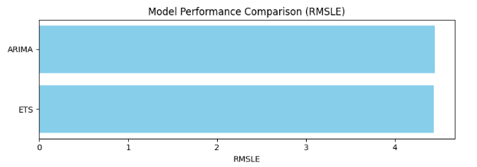
Store Sales Forecasting with ETS and ARIMA
Summary Conclusion
ARIMA and ETS effectively applied to granular time series
ARIMA showed stronger performance despite minimal tuning
Models offer practical value for retail forecast operations
Future work: add seasonality, tune parameters, assess residuals
Notes:
Summary Conclusion. This exercise illustrated time series modeling using ETS and ARIMA frameworks across granular store-family combinations. Despite limited tuning, ARIMA showed marginally superior forecasting accuracy. These methods, applied thoughtfully across many small time series, can guide retail decision-making by improving forecast precision and operational readiness. Future enhancements could involve automated parameter optimization, explicit seasonality modeling, and residual analysis.

Slide 6
House Prices Regression Modeling: Lasso and Gradient Boosting
Based on Kaggle’s 'House Prices: Advanced Regression Techniques' competition
Goal: Predict sale prices using housing features
Dataset: 70+ numeric and categorical variables
Train set includes prices; test set omits them
Focus: Develop and evaluate predictive regression models
Models and Methods
Two pipelines: Gradient Boosting and Lasso + PCA
Gradient Boosting: 300 trees, depth=4, learning rate=0.05
Lasso: Polynomial Features (degree=2) + PCA
Preprocessing: imputation, scaling, one-hot encoding
Target variable transformed using log scale
Notes:
House Prices Regression Modeling: Lasso and Gradient Boosting
This exercise is based on the Kaggle competition 'House Prices: Advanced Regression Techniques', which challenges participants to predict house sale prices based on various housing features. The dataset includes over 70 numeric and categorical variables describing aspects such as building materials, neighborhoods, lot size, and overall condition. The training set contains house prices, while the test set omits them. The objective is to model the sale price using relevant predictors and evaluate model performance.
Models and Methods. Two models were implemented using scikit-learn pipelines. The first was a Gradient Boosting Regressor with 300 estimators, learning rate 0.05, and max depth 4. The second was a Lasso regression model combined with Polynomial Features (degree 2) and PCA for dimensionality reduction. Both pipelines included preprocessing steps such as missing value imputation, standard scaling for numeric features, and one-hot encoding for categorical variables. Predictions were log-transformed during training and inverse-transformed for final output.

Slide 7
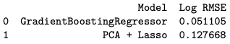
House Prices Regression Modeling: Lasso and Gradient Boosting
Assumptions & Diagnostics
Lasso: assumes linearity, L1 regularization for feature selection
Polynomial features handle interactions; PCA reduces multicollinearity
Gradient Boosting: handles non-linear relationships
No residual diagnostics plotted
Log-transform normalizes target distribution
Results & Findings
RMSE used for model evaluation
Gradient Boosting: better in-sample accuracy
Lasso + PCA: good trade-off between complexity and interpretability
Both models generated Kaggle-ready predictions
RMSE values summarized in a table
Notes:
Assumptions and Diagnostics. Lasso regression assumes linearity and performs feature selection through L1 regularization. Polynomial terms were included to capture non-linear interactions, while PCA was applied to reduce multicollinearity and dimensionality. Gradient Boosting makes no linearity assumption and is robust to feature transformations. Both models rely on cleaned, preprocessed inputs. No residual plots or multicollinearity diagnostics were explicitly generated, but log transformation was applied to normalize skewed target values.
Results and Findings. Model performance was evaluated using the Root Mean Squared Error (RMSE). The Gradient Boosting model achieved superior in-sample accuracy, while the Lasso regression pipeline demonstrated a strong balance of regularization and dimensionality handling. Both models output predictions for the test set, saved as separate Kaggle-ready submission files. RMSE values were computed for both models and compared in a summary table.

Slide 8
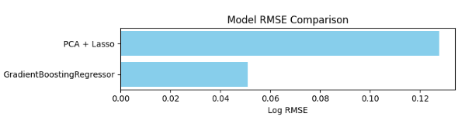
House Prices Regression Modeling: Lasso and Gradient Boosting
Summary Conclusion
Advanced models successfully predicted house prices
Gradient Boosting: strong at modeling complex data
Lasso + PCA: interpretable and efficient
Emphasizes preprocessing, transformation, and evaluation
Future work: diagnostics, ensembling, tuning
Notes:
Summary Conclusion. This analysis illustrates how advanced regression models can be constructed using polynomial expansions, regularization, and ensemble methods. Gradient Boosting is particularly well-suited for capturing complex patterns, while Lasso with PCA offers interpretability and efficiency. The approach highlights the importance of preprocessing, feature transformation, and robust evaluation when addressing real-world prediction tasks involving mixed-type datasets.

Slide 9
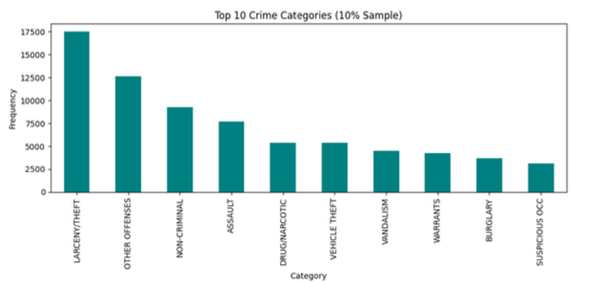
San Francisco Crime Classification: Tree-Based and SVM Models
Dataset from Kaggle: 'San Francisco Crime Classification'
Covers 12 years of police crime incident data
Objective: Predict crime category based on location, time, and district
Train data includes labels; test data used for submission
Models and Methods
Models used: Decision Tree, Random Forest, and Support Vector Classifier (SVC)
Preprocessing: timestamp parsing, spatial feature extraction
Feature pipeline: One-Hot Encoding + Standard Scaling
Dimensionality reduced using PCA
Notes:
San Francisco Crime Classification: Tree-Based and SVM Models
This study analyzes the 'San Francisco Crime Classification' dataset from Kaggle, which includes nearly 12 years of crime incident records from the San Francisco Police Department. The goal is to predict the category of a crime based on features such as timestamp, police district, location, and spatial coordinates. The training data includes labeled crime categories, while the test data lacks labels and is used for final prediction output.
Models and Methods. Three machine learning classifiers were trained to predict crime categories: a Decision Tree, a Random Forest, and a Support Vector Classifier (SVC). After basic preprocessing including timestamp parsing and location encoding, features were transformed using a pipeline combining one-hot encoding for categorical variables and standardization for numerical variables. Dimensionality was reduced using Principal Component Analysis (PCA) before feeding into models.

Slide 10
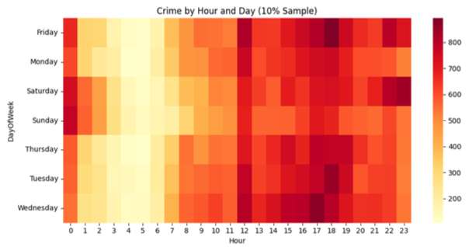
San Francisco Crime Classification: Tree-Based and SVM Models
Assumptions & Diagnostics
Decision Tree & Random Forest require minimal preprocessing
SVC assumes scaled input and benefits from PCA
Filtered out underrepresented classes (< 20 instances)
Evaluation metric: Multiclass Logarithmic Loss
Results & Findings
Models trained on stratified 10% sample for speed
Predictions exported for all 39 crime categories
Log loss scores computed for each model
Random Forest and Decision Tree performed well
SVC delivered competitive accuracy after PCA
Notes:
Assumptions and Diagnostics. The Decision Tree and Random Forest assume minimal preprocessing and are robust to variable types and scales. SVC assumes that input features are on a similar scale and benefits from PCA to address high-dimensional input after encoding. Class labels with insufficient data (fewer than 20 instances) were filtered to preserve stratified sampling integrity. Model performance was evaluated using multiclass logarithmic loss.
Results and Findings. Each model was trained on a stratified 10% subset of the full dataset to improve computational efficiency. Predictions were made on the test dataset and exported in submission-ready CSV format including all 39 possible crime categories. Log loss scores were computed for validation sets, and performance comparisons were visualized using bar plots. Random Forest and Decision Tree classifiers showed strong classification capability; SVC provided competitive results with dimensionality reduction.

Slide 11
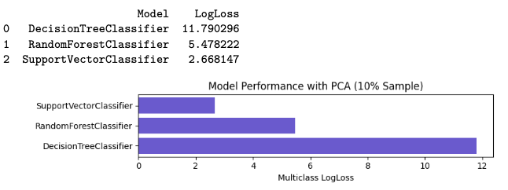
San Francisco Crime Classification: Tree-Based and SVM Models
Summary Conclusion
Tree-based models and SVC successfully applied to crime classification
PCA improved modeling efficiency in high-dimensional space
Models evaluated with probabilistic metrics like log loss
Future work: explore ensembles, time-series patterns, and geo-clustering
Notes:
Summary Conclusion. This project demonstrated the effective application of tree-based classifiers and support vector machines on a multi-class classification problem involving spatial-temporal crime data. PCA improved efficiency in high-dimensional feature space, and model performance was evaluated using appropriate probabilistic loss metrics. Future improvements could explore time-series segmentation, ensemble methods, and geographic clustering for localized crime modeling.

Slide 12
References and Appendix
Alexis Cook, DanB, inversion, and Ryan Holbrook. Store Sales - Time Series Forecasting.
https://kaggle.com/competitions/store-sales-time-series-forecasting, 2021. Kaggle.
Anna Montoya and DataCanary. House Prices - Advanced Regression Techniques.
https://kaggle.com/competitions/house-prices-advanced-regression-techniques, 2016.
Kaggle.
Wendy Kan. San Francisco Crime Classification. https://kaggle.com/competitions/sf-crime,
2015. Kaggle.
Hinton, W. (2025), Build and Evaluate Unsupervised Models Using Wine Clustering Dataset.
National University.
Hinton, W. (2025), Multi-Class Prediction of Obesity Risk Using Classification Models.
National University.
James, G., Witten, D., Hastie, T., Tibshirani, R., & Taylor, J. (2023). An introduction to
statistical learning with applications in Python. Springer Nature.
Hastie, T., Tibshirani, R., & Friedman, J. H. (2009). The elements of statistical learning:
data mining, inference, and prediction. 2nd ed. Springer.

Slide 13
Appendix – Exercises, Notebooks and Submissions
This assignment as a series Kaggle exercises of multiple models build types and evaluations was completed using Jupyter notebooks. The corresponding dataset exercise, notebooks and evidence submissions are list here.
Store Sales Time Series Forecasting: ETS and ARIMA Models
Kaggle dataset - https://www.kaggle.com/competitions/store-sales-time-series-forecasting/data
Jupyter Notebook – storesales.ipynb
GitHub repository - https://github.com/whinton0/py
Submission image - submit_Image_storesales.png
House Prices Regression Modeling: Lasso and Gradient Boosting
Kaggle dataset - https://www.kaggle.com/competitions/house-prices-advanced-regression-techniques/overview
Jupyter Notebook – houseprices.ipynb
GitHub repository - https://github.com/whinton0/py
Submission image - submit_Image_houseprices.png
San Francisco Crime Classification: Tree-Based and SVM Models
Kaggle dataset - https://www.kaggle.com/competitions/sf-crime/overview
Jupyter Notebook – sfcrimemodels.ipynb
GitHub repository - https://github.com/whinton0/py
Submission image - submit_Image_sfcrime.png
Notes:
.

Slide 14
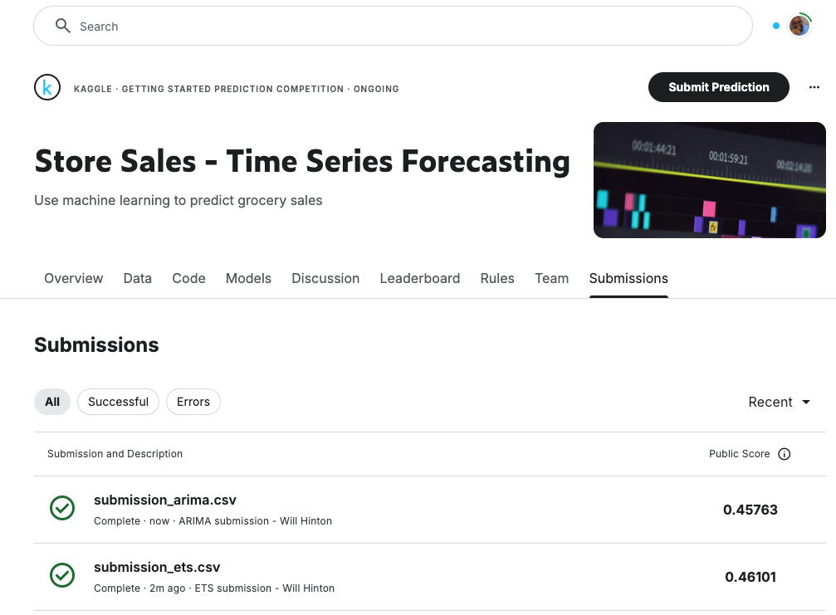
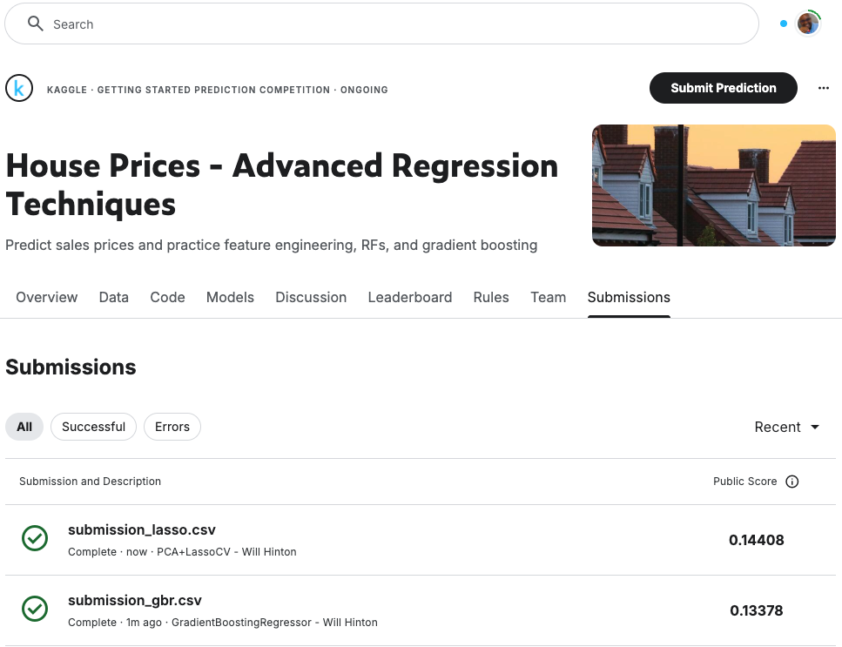
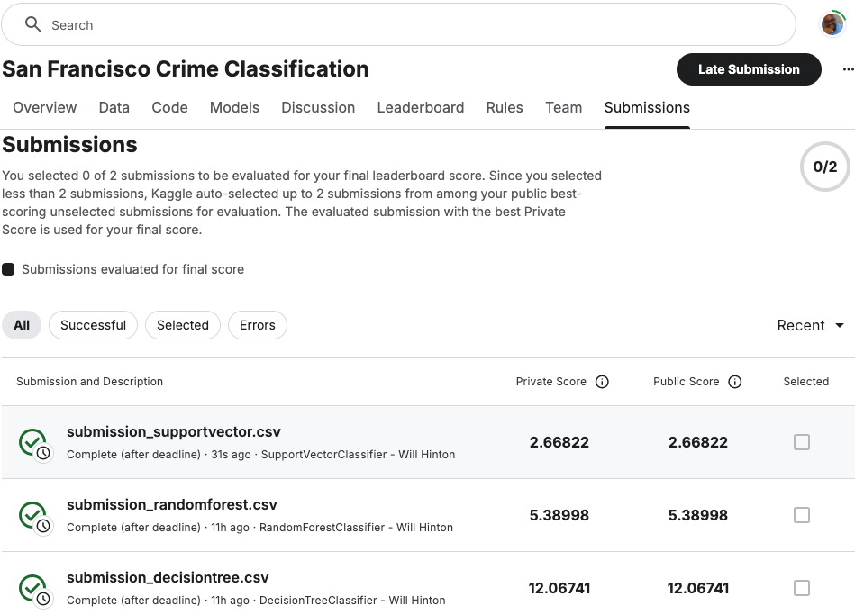
Appendix – Exercises, Notebooks and Submissions
Notes:
.

